Slide 1

IBERO-AMERICANA DE LIBROS ACADÉMICOS
«A Modest Proposal»

Slide 2
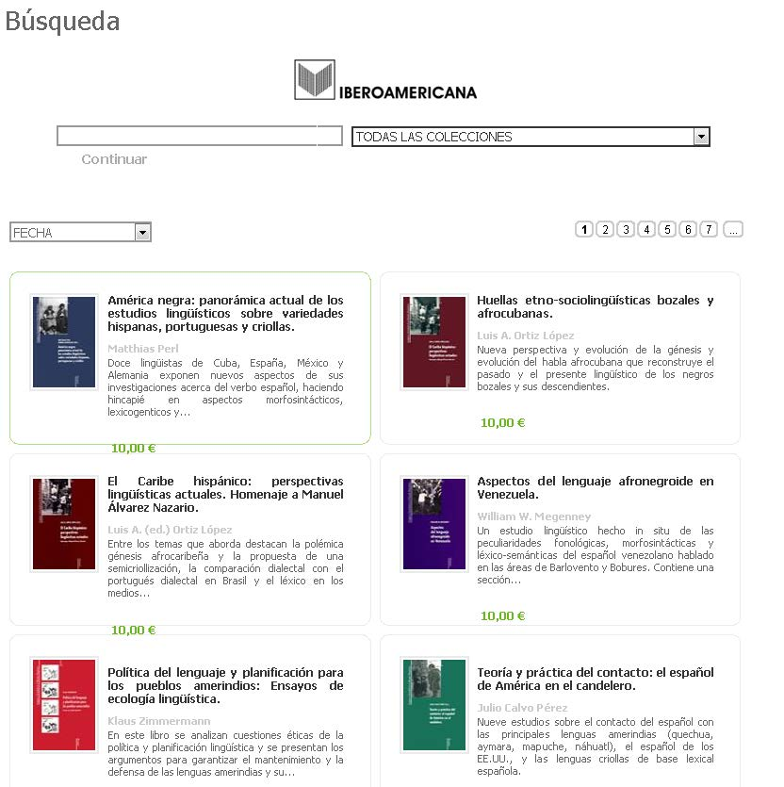
www.todoebook.com

Slide 3
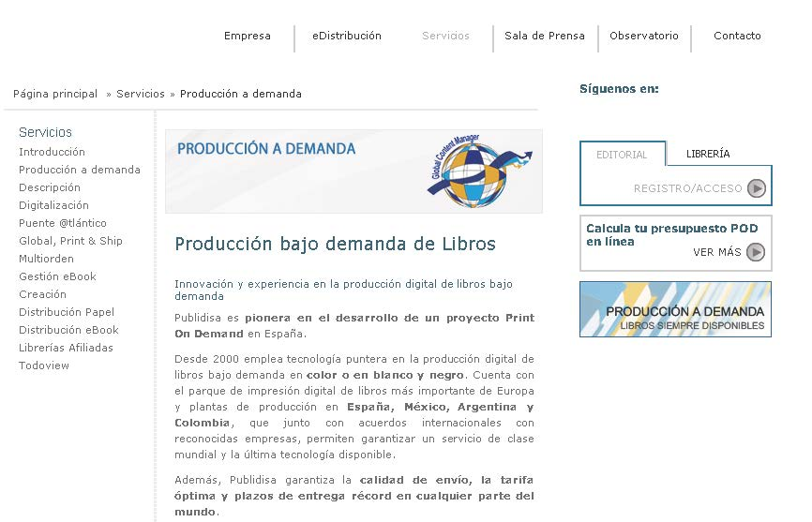
Servicio POD

Slide 4
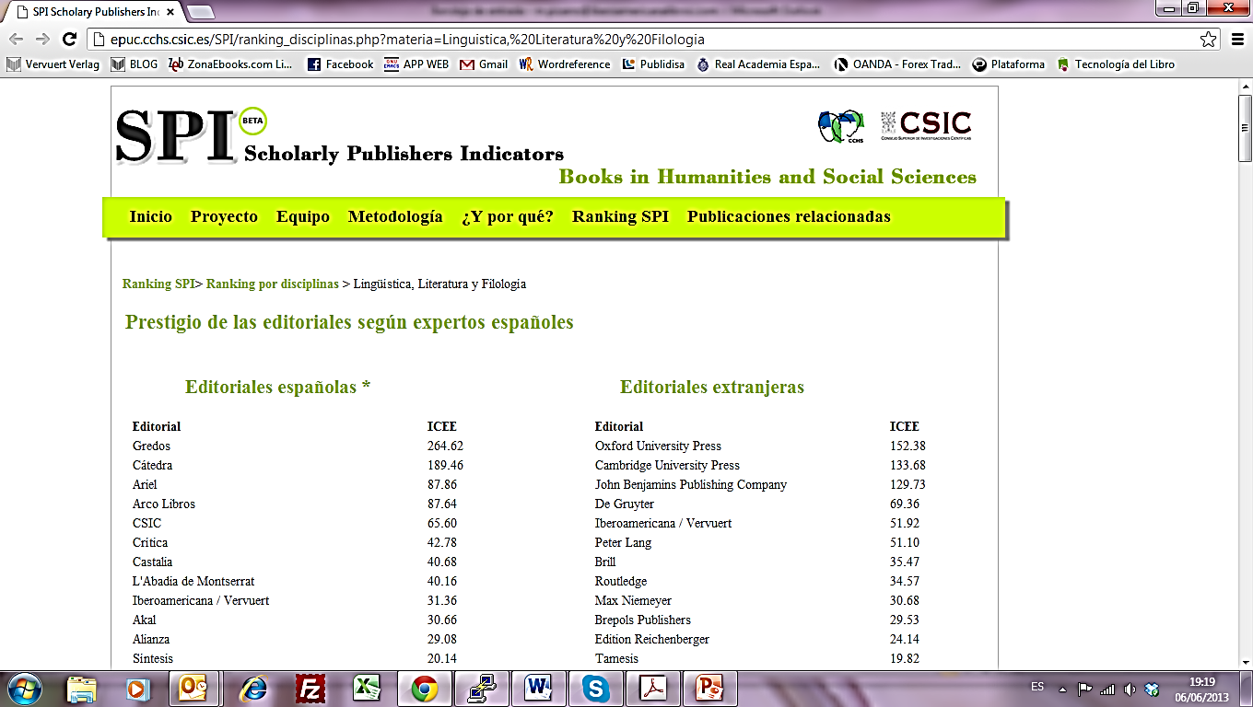
SPI: Scholarly Publishers Indicators
CSIC: Consejo Superior de Investigaciones Científicas
http://epuc.cchs.csic.es/SPI/ranking_disciplinas.php?materia=LinEditoriales extranjeras

Slide 5
(e)Book Cost I
Paperback COST | Ebook COST
Proofreading/editing/corrections: 400 € (approx., depends on number of pages) | [Proofreading/editing/corrections: 400 € (approx., depends on number of pages)]*
Typesetting: 600 € (appox.) | Typesetting: add 0.75 appox per page to convert it into Epub. First typesetting needs to be done anyways.
Cover design: around 300€ | [Cover design: around 300€]*
Print: Depends on print-run and book features, our average is 1000 €

Slide 6
(e)Book Cost II
Paperback COST | Ebook COST
Warehouse fees: In short print-run like ours, this is not much. Our average per month is 500 €. | Platforms fees: When selling, they take around 45-55% of final price; when renting, from 45% up to 55% per purchase. For our own platform, we have to pay a percentage of total selling at the end of the year.
Other costs: personnel, there is a number of hours that the editor in charge of the book obviously invests in each book, so a percentage of his/her salary has to be taken into account per each book | Other costs: Compared to the number of hours an editor invests on making a book, the ebook takes more time: files have to be prepared for each platform, keep track of modifications, updates, metadata, etc.*

Slide 7

Ebooks For Direct Purchase in Our Web

Slide 8
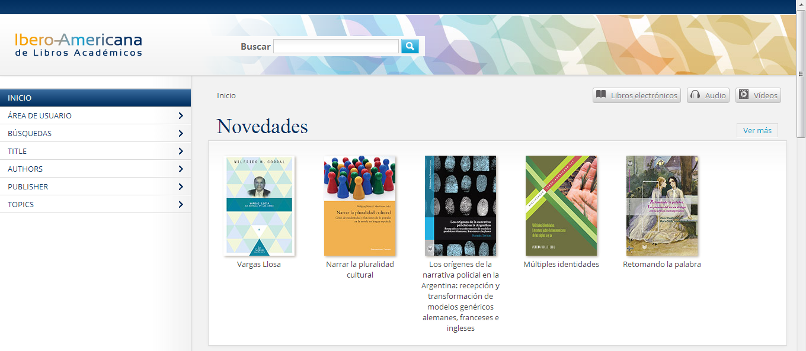
Ibero-Americana de Libros Académicos

Slide 9
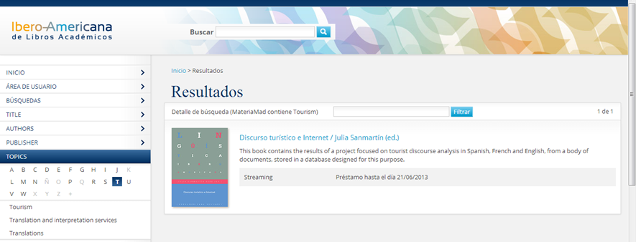
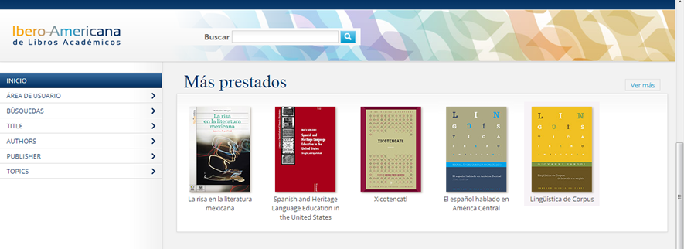

Slide 10
Ibero-Americana de Libros Académicos
IP validation
Read on Streaming
Simultaneous usage accepted.
VPN and Proxy connection accepted
Printing of 20 pages allowed
Marc Records provided
Free demo Access of 15 days

Slide 11
IBEROAMERICANA EDITORIAL VERVUERT
THANK YOU
María Pizarro Prada, Ph.D.
E-Content manager and editor
m.pizarro@iberoamericanalibros.com

