Slide 1

Access to e-books in
UK deposit libraries
Richard Gibby, British Library
ACLAIIR
18th June 2013

Slide 2
Introduction
User experience
Collecting models
Legal deposit
Future expectations

Slide 3
Some user experience differences?
Printed books
Catalogue records
Time to order up
Standalone
Consult several titles at once on the desktop
Internally “browsable”
Familiar reading experience
Electronic books
Metadata
Instant retrieval
Device-dependent
Portable, but consulting one title at a time
Internally searchable
Zooming, text to speech, additional media and interactive elements?

Slide 4
Copyright law
DRM technical
protections
E-Readers,
Tablets…
Licence Terms
DRM technical
protections
  PC screens,
  Tablets,
  E-Readers
Purchased
Licensed
Donated
Deposited
Copyright
law
DRM-free?
PC screens,
Tablets, E-Readers
    Legal
    deposit
  DRM free, but
  strictly
  controlled

Slide 5

“Legal deposit helps to ensure that the nation’s published output, and thereby its intellectual record and future published heritage, is collected systematically, both in order to preserve the material for the use of future generations and to make it available for readers within the designated deposit libraries.” – British Library website
Benefits:
  Supporting research and culture
  Supporting innovation and economic value creation
Balance of responsibilities:
  Publishers bear responsibility of depositing
  Deposit libraries bear responsibility of preserving
Balance of interests:
  Rights holders: intellectual property business models
  Public: national collection with continuity of access
What is legal deposit?

Slide 6






Deposit with British Library (Boston Spa)
Content shared and distributed to four nodes:
- Boston Spa
- St Pancras
- Aberystwyth
- Edinburgh
Access at each node, and by secure network for
- Cambridge Univ.
- Oxford Univ.
- Trinity College
Dublin
NLS
Edinburgh
British Library
Boston Spa
Trinity Coll.
Dublin
NLW
Aberystwyth
Cambridge
Univ.
Bodleian
Oxford
British Library
St Pancras
Shared Implementation

Slide 7


Collecting the material
  Deposit libraries entitled to copy relevant material from the internet
  Publisher must provide password (subject to 1 month’s notice) for the library to harvest pay wall protected content*
  A library and publisher may use another delivery method for deposit, by mutual agreement.
  Publisher must deposit offline works (on CD-ROM…)*
  For publications available in print and non-print, deposit obligation remains print until non-print medium agreed
  * = excludes micro-businesses until 31 March 2014
Using the material
Access only on Library premises
One concurrent user per work
No digital copying
Fair dealing print copies
Embargos possible
Collaboration in JCLD
Undertaking on security
Dispute resolution procedure
Summary of the 2013 Regulations

Slide 8
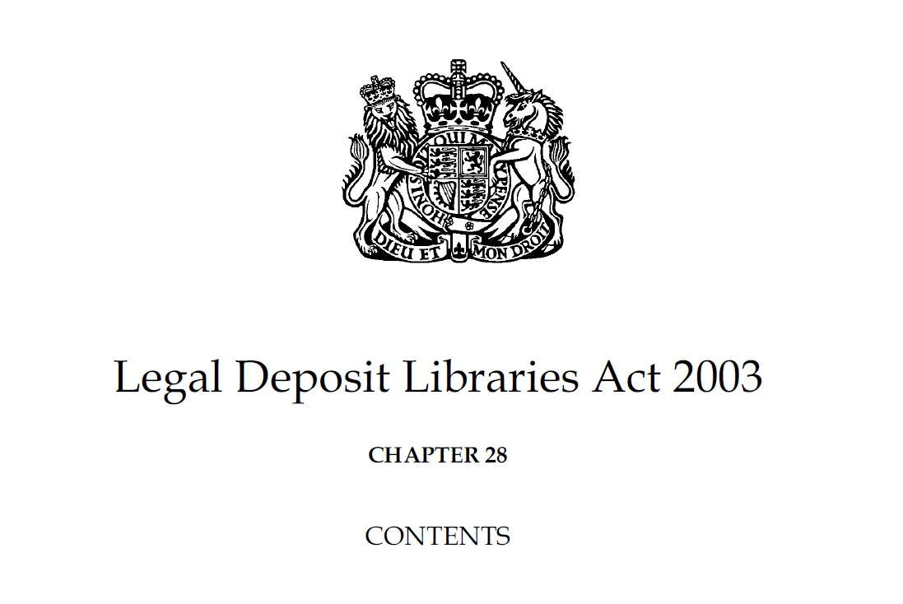
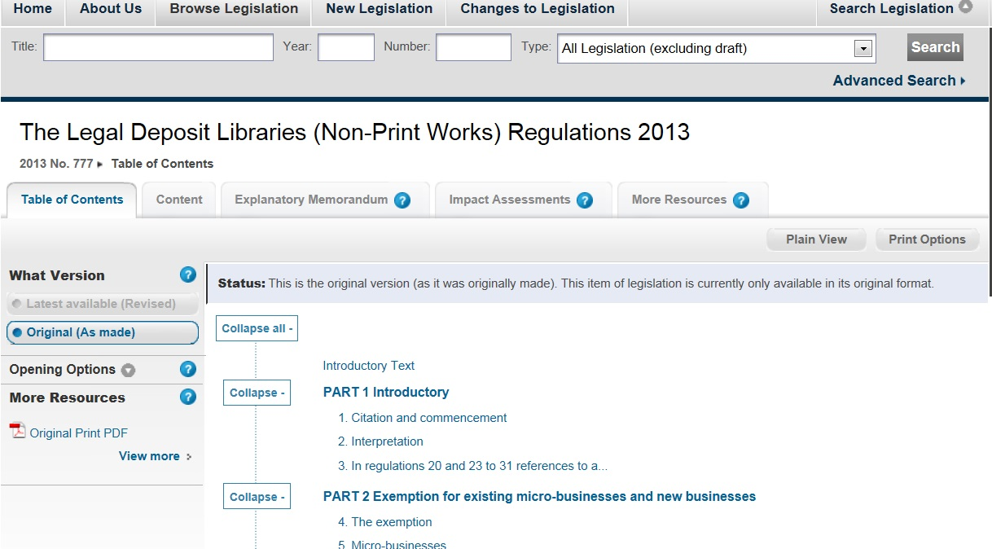
Legal deposit e-books on tablet PCs?
“23. A deposit library must ensure that only one computer terminal is available to readers to access the same relevant material at any one time”

Slide 9
Questions?

