Slide 1
Why can’t we all read it at once?
Issues surrounding e-book acquisition
Ruth Dale, Resource Acquisition Librarian
ruth.dale@nottingham.ac.uk

Slide 2
Library Ebook “Acquisition”
Finding and choosing
Buying
Making available
and also, for “e “specifically…
Choosing titles – selection models
Post-purchase – the never-ending story?

Slide 3
Request to buy a book
Is it in print or not?
Choose supplier
Send order
Receive book, process and forget
Print books – if you can get them, they work (usually)

Slide 4
Where will the ebooks be?
It is clear where the print books are – on a shelf (or, hopefully, out on loan)
The ebooks?
  Most likely NOT actually hosted/stored by the Library
  May be accessed direct from the publisher website
  May be accessed via a third-party interface (aggregator)

Slide 5
Finding and choosing: availability
Can I get this in “e”?
Publishers
  may not want to make available as “e”
  may sell all ebooks to individuals for their own use
  may sell some individual ebooks to Institutions
  may sell “packages” of ebooks to Institutions
  may use 3rd party aggregators to sell their ebooks – just one, or multiple ones

Slide 6
Finding and choosing – where check
Library supplier/aggregator
  Their own interface, variety of available models –restrictions will vary for certain books
Bibliographic database – Nielsen Bookdata or similar
  Information fed through varies
Publisher?
  Is the info there for institutional purchase?

Slide 7
Access Models
  Unlimited access
  Fixed concurrent users
  Credits
  Short term loans/rentals
  Subscription
  Downloads/read offline
  (NB controlled by DRM – digital rights management

Slide 8
Finding and Choosing – questions to ask first!
How will it be used? Occasionally, as extra reading, or heavily as set text/class use?
If it isn’t on a reading list/set reading, do we really need to “own” it permanently?
    Rental/short term loan
    PDA/DDA – patron or demand-driven Acquisition

Slide 9
Patron Driven Acquisition – allowing library users to choose
Usually via an “aggregator” (though publishers also now offering their own variants)
Usually an element of pre-selection (identifying broadly appropriate titles)
Users find records of titles in library catalogue – not necessarily clear that not yet “owned”
Short period of preview, or number of short-term loans triggers a purchase

Slide 10
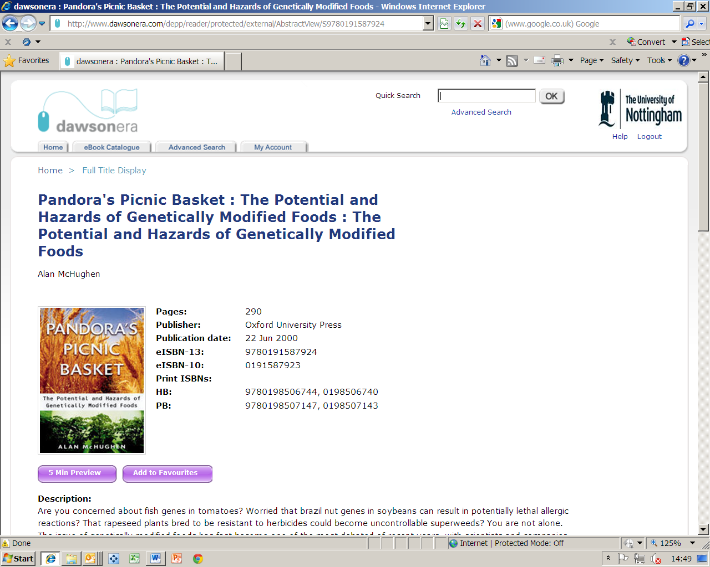

Slide 11
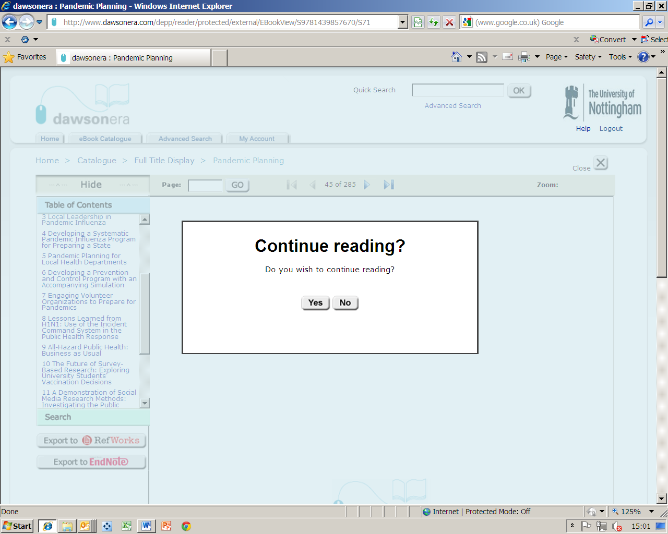

Slide 12
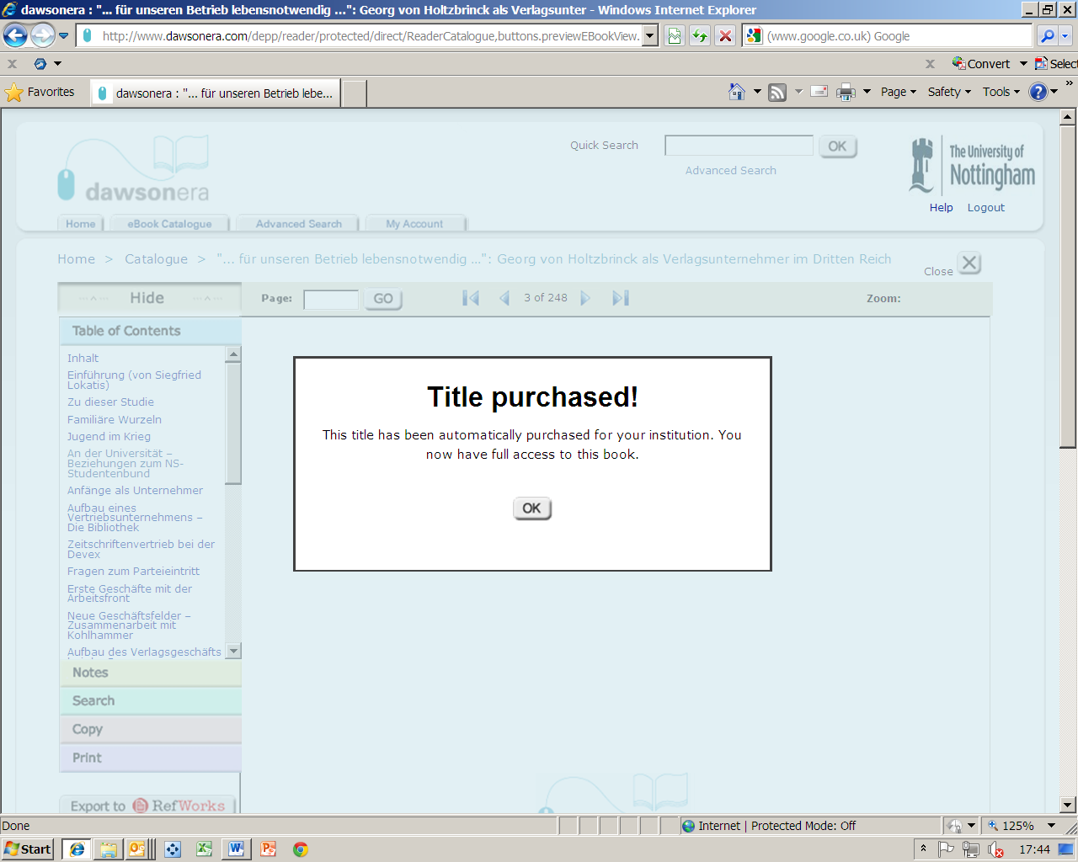

Slide 13
Buying
Default decision-making workflow
  aggregator that suits most purposes
  second choice, publisher if available
Workflow – integration with Library Management System (send order, receive invoice etc)?
  Library suppliers/aggregators largely able to do this – mirrors system used for print
  Publishers largely NOT yet set up like this

Slide 14
Making available
No printed book received to trigger a “process” – but you SHOULD get
Notification of the access set up
A “catalogue” record incorporating the URL link for the title
An invoice (probably electronically)
Does your usual process for publicising new books work – can you MAKE it?

Slide 15
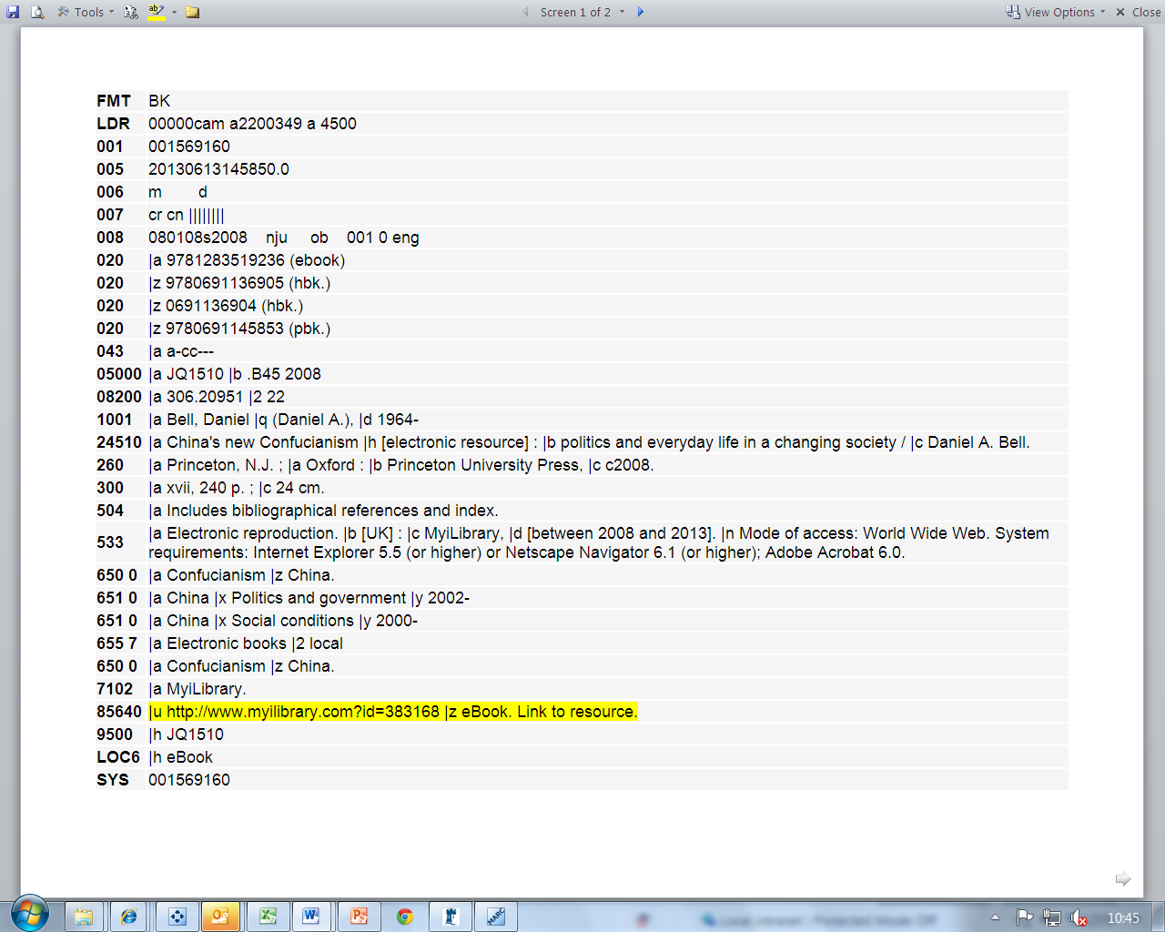
Link in catalogue is crucial

Slide 16
Post-purchase
Ideal scenario: ebook added to stock, works like clockwork, allows users to print/save/download from anywhere in the known world
Likely scenario: you may need to troubleshoot issues such as:
Authentication – users identifying themselves
Format – using online or downloads, what device, what authentication etc
Changes in patterns of use – may need to buy additional copies, change sim user licence, remove and buy NEW EDITION!
Worst-case scenario: access model can change…

Slide 17
Summary – and future development?
Ebook acquisitions – decisions “front-loaded”
  Lots of questions to consider if choice of access!
Market fluid – more content being added, but more restrictions too
Purchasing workflows – adapting slowly
Future – continuing on-going preference for print?
Ebook collections “given” to students?

